Slide 1
A Presentation on “Project” ELE-DESK
Group Member
Jimit .S. Dagli (206090307002)
Vishal .R. Parmar (206090307031)
Sumeet .Kapadia (206090307059)
Tirth .M. Doshi (206090307063)
Internal Guide
Mr. B. D. Limbasiya
Computer Engineering Department
C U Shah (Govt) Polytechnic - Surendranagar

Slide 2
Problem
So what was the problem for choosing this project….???
In our experience, many dealers and wholesalers suffer in the offline market when visiting the seller's location to purchase the product.
Due to offline market purchases, dealers and wholesalers lose valuable time, travel money, and tracking information.

Slide 3
Solution
Dealers and wholesalers will be able to order the products online through this project.
Save travelling money.
Save crucial time.
No crowds.

Slide 4
Abstract
The title of the project is "Ele-Desk".
"Ele-Desk" project involves the sharing of resources between a Admin, Dealers, and Wholesalers.
In this project, we are “Zell Electronics”. The company which manufactures mobile phones, televisions, laptops etc products.
Admin will be the main supplier.
Orders will be placed by Dealers and Wholesalers. Once they purchase the products, they will get the discount as per their orders.

Slide 5
Introduction
“Ele-Desk Management System” contains 4 main modules. They are:--
Admin Module:---
Admin can create the accounts of dealers. He can manage the stock, discount of products. He can receive orders from dealers and dispatch the products to them.
Dealer Module:--
Dealer can create the accounts of wholesalers. He can view the products that admin is selling.He can manage the stock of products. He can send orders to admin and receive orders from wholesalers. He can dispatch the products to wholesalers.
Wholesaler Module:--
Wholesalers can manage the stock of their products, view the products that dealer is selling and can send orders to dealers.

Slide 6
Literature Review /Study
We got some ideas from general business problems like to purchase the stock of products by travelling long distance to purchase their products.
We also got the idea from the website called delhivery.com. It is somewhat similar to this project.
Reference Link:--- https://www.delhivery.com/setup-business/blogs/

Slide 7
Platform
Front End:-- HTML, CSS, Java Script
BACK END:-- PHP
DATABASE TOOL:-- MY SQL

Slide 8
Challenges
To manage the Stock of Admin,Dealers and Wholesalers.
To manage the Fault Products.
To manage the Orders.

Slide 9
Features
The Dealers and Wholesalers are able to place orders easily.
The Dealer and Wholesalers both of them are able to get discount according to their purchases.
If the Dealers or Wholesalers receive the faulty or broken products they can claim their warranty.
Better collaboration and improves relationship.
Benefits of technologies.

Slide 10
End Users
Admin/Supplier
Dealers
Wholesalers

Slide 11
Scope
Using our project the Dealers and Wholesalers are able to easily place the order to the Supplier.
This will save a lot of time and money of Dealers and Wholesalers.

Slide 12
Objectives
Save time of Dealers and Wholesalers.
Efficiency.
Preventing the extra cost of travelling of Dealers and Wholesalers.

Slide 13
Motivation
Motivation for this project is that the Dealers and Wholesalers face a trouble in offline order.
The outcome for this project is that we are able to place the orders online.
The Admin, Dealers and Wholesalers all of them will be benefitted.

Slide 14
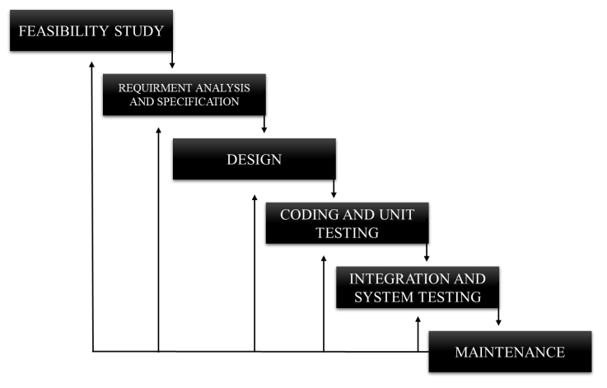
Software Development Cycle
(Iterative Waterfall Model)

Slide 15
Software Development Cycle
We chose “Iterative Waterfall Model” for this project.
Reasons:--
It is very simple to understand and use.
Testing during smaller iteration is easy.
Less time is spent on documenting and more time is given for designing.
Risks are identified and resolved easily.
It is highly cost-effective to change the plan or requirements in the model.
Unlike Waterfall Model, Iterative Waterfall Model allows to make changes by going to the previous phase.
Parallel Development can be done.

Slide 16
Project Plan And Schedule
Project Title: Ele-Desk
Sr No | Milestone | Start Date | End Date /Milestone Date | Duration (Days)
1 | Requirement Gathering | 18-07-2022 | 31-07-2022 | 14
2 | Analysis and Module Specification | 01-08-2022 | 20-08-2022 | 20
3 | Planning and Risk Identification | 21-08-2022 | 25-08-2022 | 5
4 | UML Diagram Designing | 26-08-2022 | 14-10-2022 | 50
5 | Database Design, Sample Page Design | 15-10-2022 | 08-11-2022 | 25
6 | Project-1 Documentation | 09-11-2022 | 28-11-2022 | 20
7 | GUI Design | 01-01-2023 | 31-01-2023 | 31
8 | Coding and Implementation | 01-02-2023 | 12-03-2023 | 40
9 | Deployment | 13-03-2023 | 01-04-2023 | 20
10 | Testing | 02-04-2023 | 16-04-2023 | 15
11 | Documentation | 17-04-2023 | 01-05-2023 | 15
Total Days |  |  |  | 255

Slide 17
SRS
Admin:--
R1 :-- Login Account
Input:-- Enter username and password.
Output:-- Login Successful.
R 1.1:-- Create Account for Dealer of specific area
Input:-- Click on “Account” menu,select “Dealer Account” than enter username and password and click on “Create Account”.
Output:-- Account Created Successfully.
R 1.1.1 :-- Enter details of Dealer
Input:--- Enter details.
Output:-- Details Saved.
R 1.2:-- Add Products
Input:-- Click on “Product” menu, Click on “Add Product” option then select the products and then Click on “Add Products”.
Output:-- Added Successfully.

Slide 18
SRS
R 1.2.1 :-- Check the Stock of Products
Input:-- Click on “Stock” menu.
Output:-- Stock of Products are displayed.
R 1.3 :-- Check for Orders Received
Input:-- Click on “Order” menu and click on “Orders Received” submenu.
Output:-- Received Orders are displayed.
R 1.3.1 :-- Add Discount to Products
Input:-- Click on “Order” menu, click on “Orders Received” submenu then select “Add Discount” option and enter discount.
Output:-- Discount added Successfully.
R 1.4 :-- Dispatch Products
Input:-- Click on “Order” menu, select “Dispatch Details” submenu then enter details and then click on “Dispatch Product”.
Output:-- Dispatched Successfully

Slide 19
SRS
R 1.5:-- Faulty Piece are received from Dealers
Input:-- Click on “Customer Care” menu, select “Falty Product” submenu and then check for faulty products.
Output:-- Faulty Products are received.
R1.5.1 :-- Replace the Faulty Products
Input:-- Select the products to replace.
Output:-- Replaced Products sent Successfully.

Slide 20
SRS
Dealers :--
R 2.1:-- Login Account
Input:-- Enter username and password.
Output:-- Login Successful.
R 2.2 :-- Create Accounts for Wholesalers
Input:-- Click on “Account” menu,select “Wholesaler account” than enter username and password and click on “Create Account”.
Output:-- Wholesaler account created Successfully.
R 2.3:-- Add Products
Input:-- Click on “Product” menu, Click on “Add Product” option then select the products and then Click on “Add Products”.
Output:-- Added Successfully.
R 2.3.1 :-- Check the Stock of Products
Input:-- Click on “Stock” webpage.
Output:-- You can see the stock of products.

Slide 21
SRS
R 2.4:-- Send Order to Supplier
Input:-- Click on “Order” menu, select the Products and Quantity to order, Click on “Send Order”.
Output:-- Order Sent Successfully.
R 2.4.1 :-- Received Order from Supplier
Input:-- Click on “Order” menu, Click on “Order Received” section then click on “Received Order” submenu.
Output:-- Order Received Successfully.
R 2.5 :-- Received Orders from Wholesalers
Input:-- Click on “Order” menu, Click on “Order Received” section, then check for Received Orders and for the sender.
Output:-- Order Received Successfully.

Slide 22
SRS
R 2.6:-- Dispatch Products
Input:-- Click on ”Order” menu, select “Dispatch Details” and enter details and then click on “Dispatch Product”.
Output:-- Dispatched Successfully.
R 2.7 :-- Faulty Products are received from Wholesalers and replace them
Input:-- Click on “Customer Care” menu, select “Faulty Product”, select products to replace and click on “Replace Products”.
Output:-- Replaced Products sent Successfully.

Slide 23
SRS
Wholesalers :--
R 3.1 :-- Login Account
Input:-- Enter username and password.
Output:-- Login Successful.
R 3.2 :-- Check the Stock of Product
Input:-- Click on “Stock” webpage.
Output:-- You can see the stock of products.
R 3.3:-- Send Order to Dealer
Input:-- Click on “Order” menu, select the Products and Quantity to order, Click on “Send Order”.
Output:-- Order Sent Successfully.

Slide 24
SRS
R 3.4 :-- Faulty Products are sent to Dealer
Input:-- Click on “Customer Care” menu, select “Falty Product” submenu then select product and Click on “Sent Faulty Products”.
Output:-- Faulty Products sent Successfully.
R 3.5:-- Replaced Products are Received
Input:-- Click on “Customer Care” menu, then click on “Replaced Product”.
Output:-- Replaced Product Received Successfully.

Slide 25
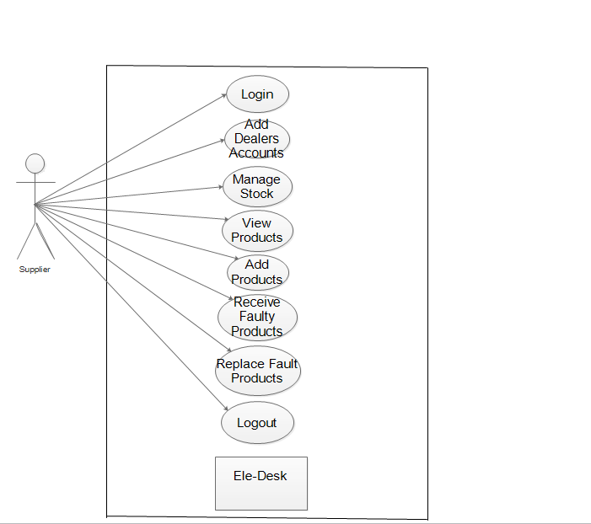
Use Case Diagram
Supplier

Slide 26
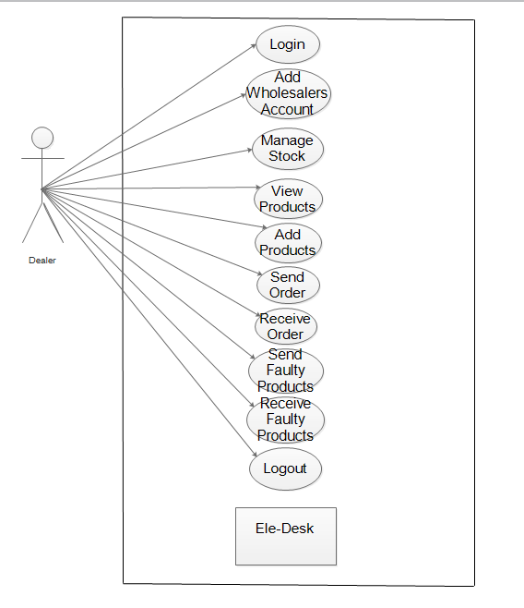
Use Case Diagram
Dealer

Slide 27
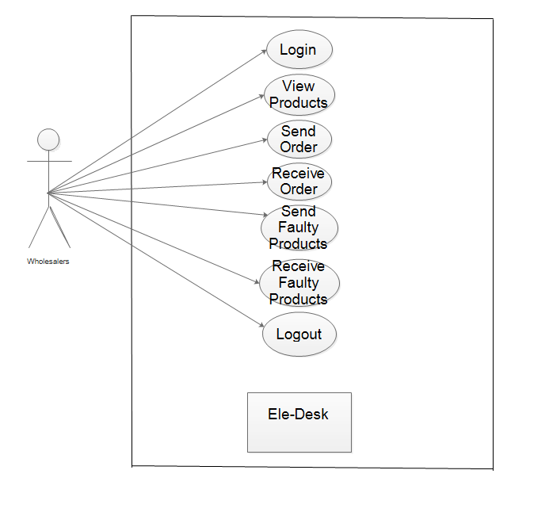
Use Case Diagram
Wholesalers

Slide 28
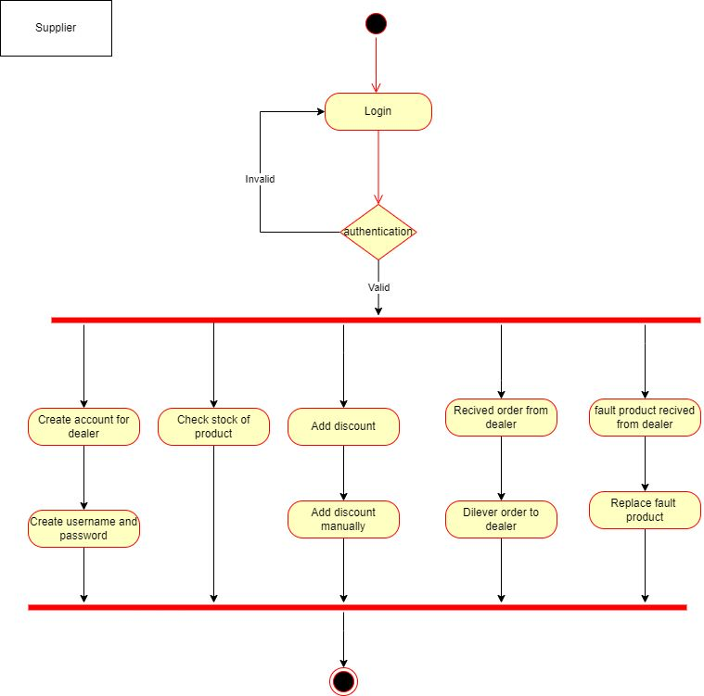
Activity Diagram
Supplier:--

Slide 29
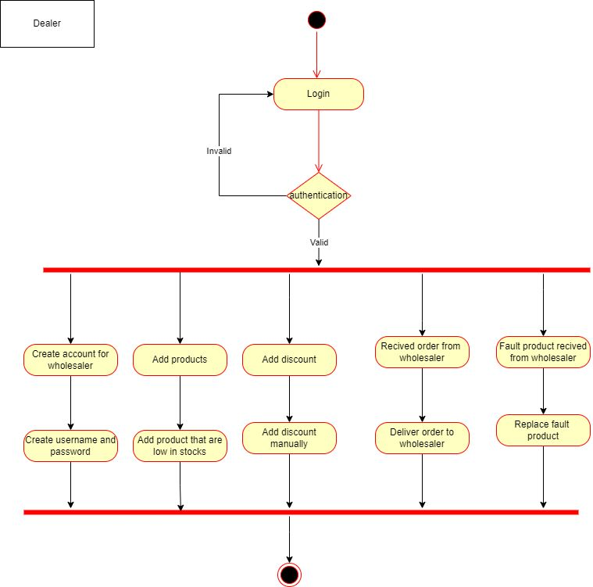
Activity Diagram
Dealer:--

Slide 30
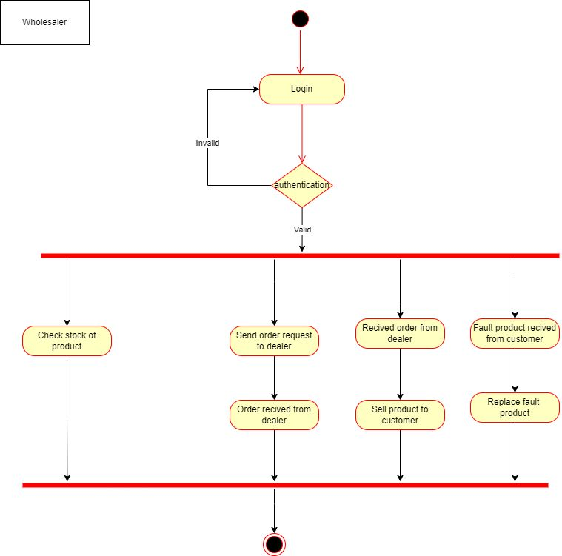
Activity Diagram
Wholesaler:--

Slide 31
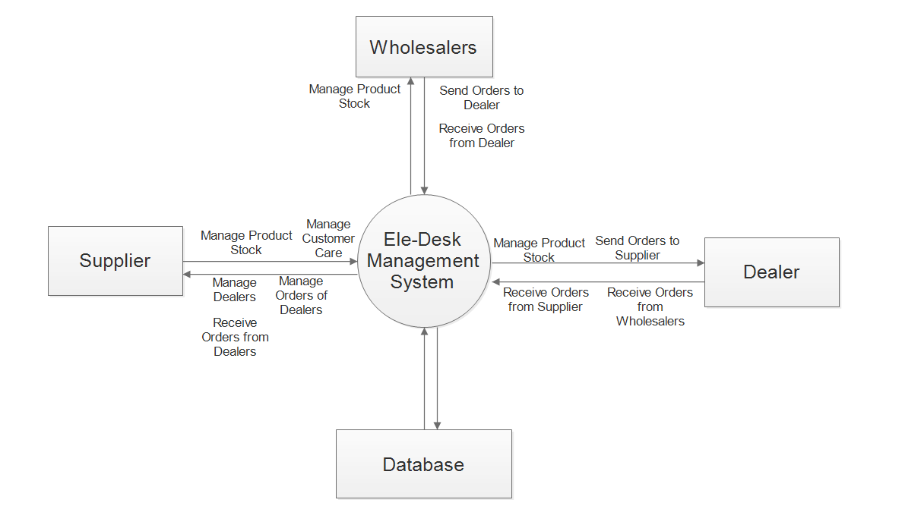
Level 0 DFD

Slide 32
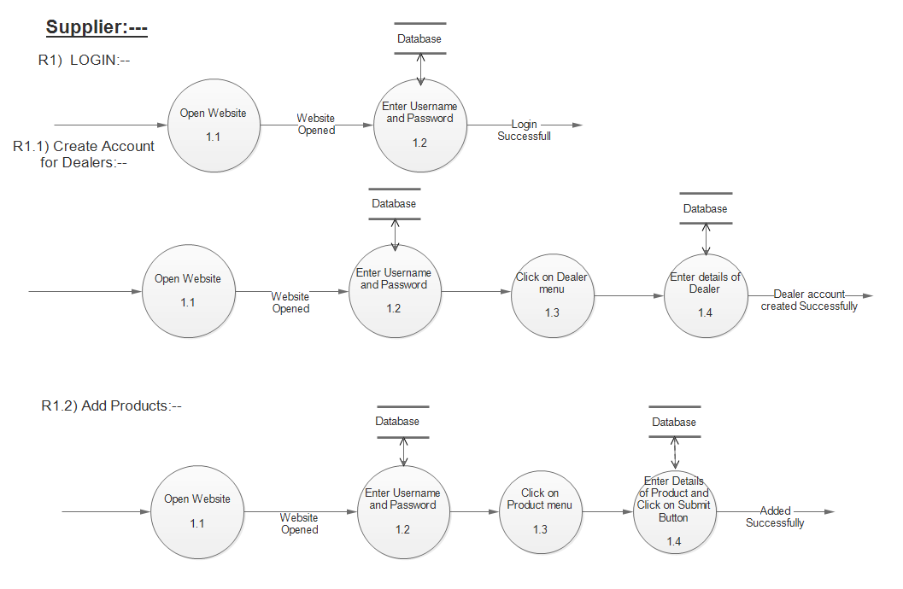
Level 1 DFD
Supplier:--

Slide 33
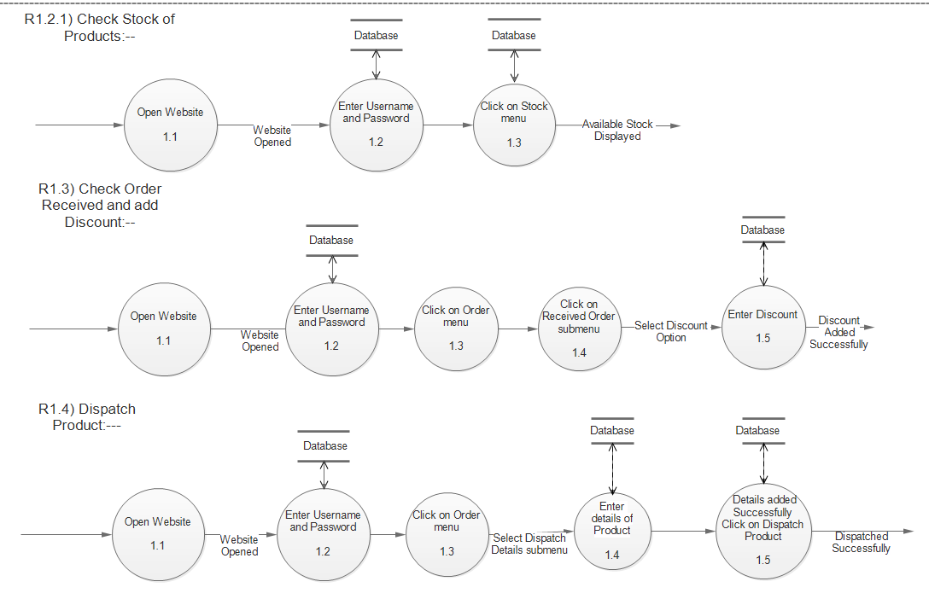
Level 1 DFD

Slide 34
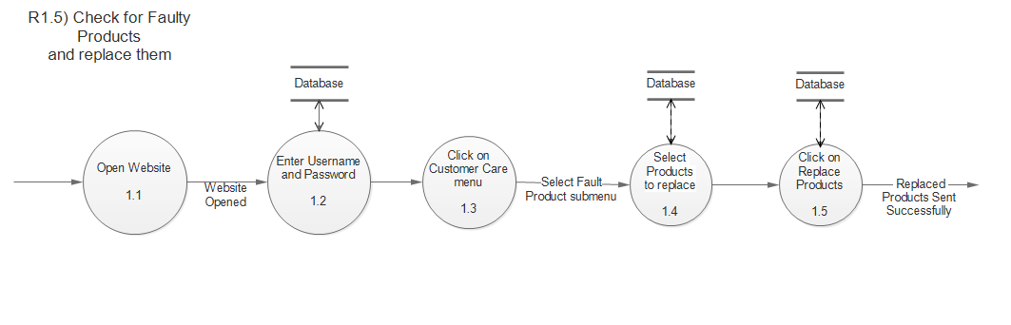
Level 1 DFD

Slide 35
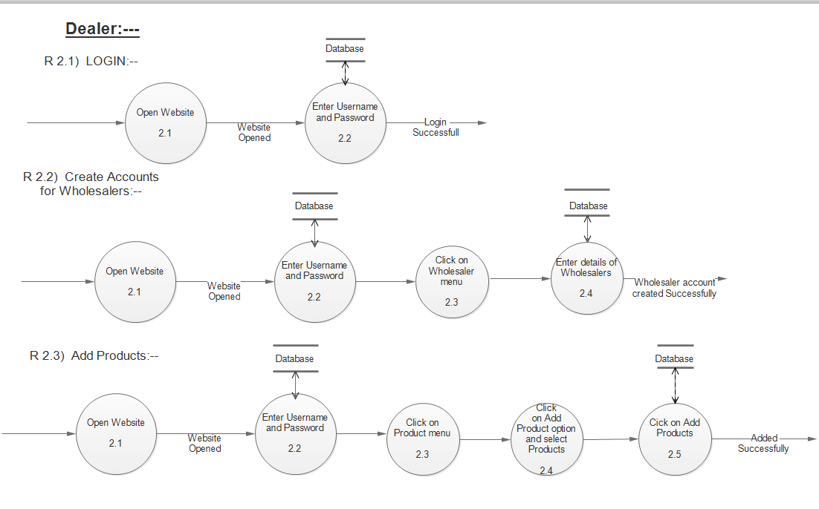
Level 1 DFD
Dealer:--

Slide 36
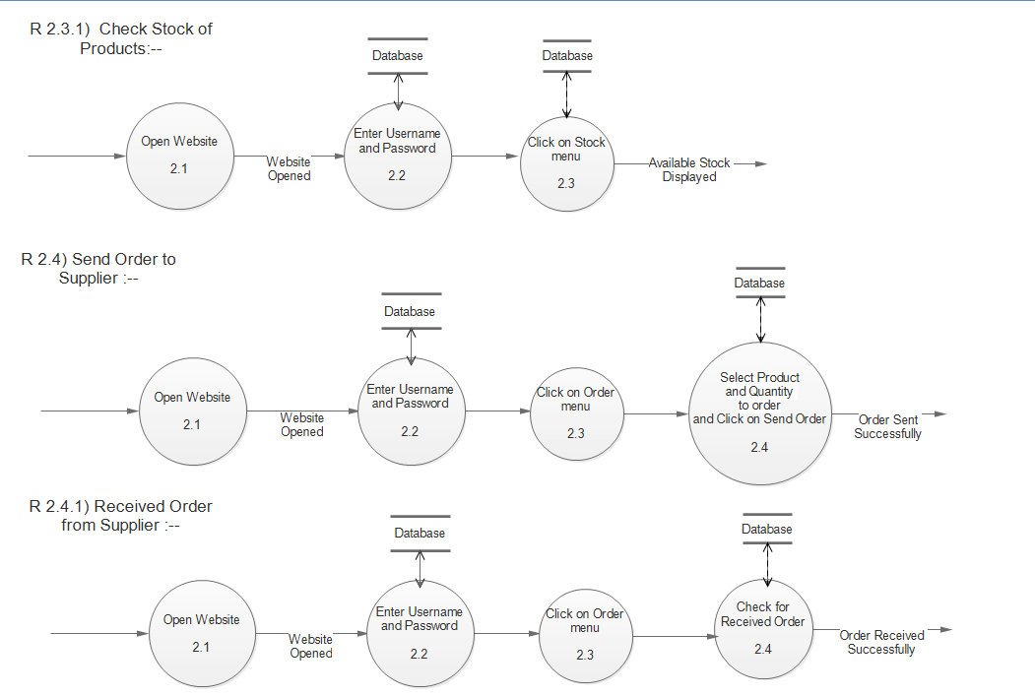
Level 1 DFD

Slide 37
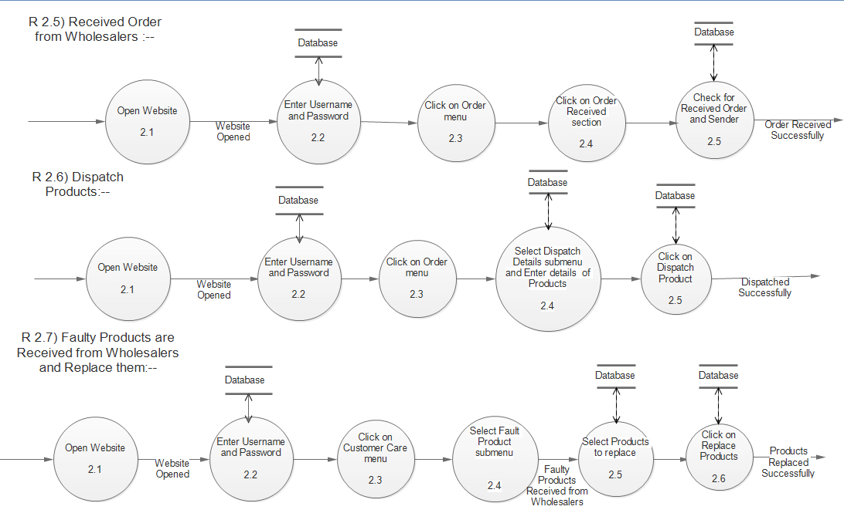
Level 1 DFD

Slide 38
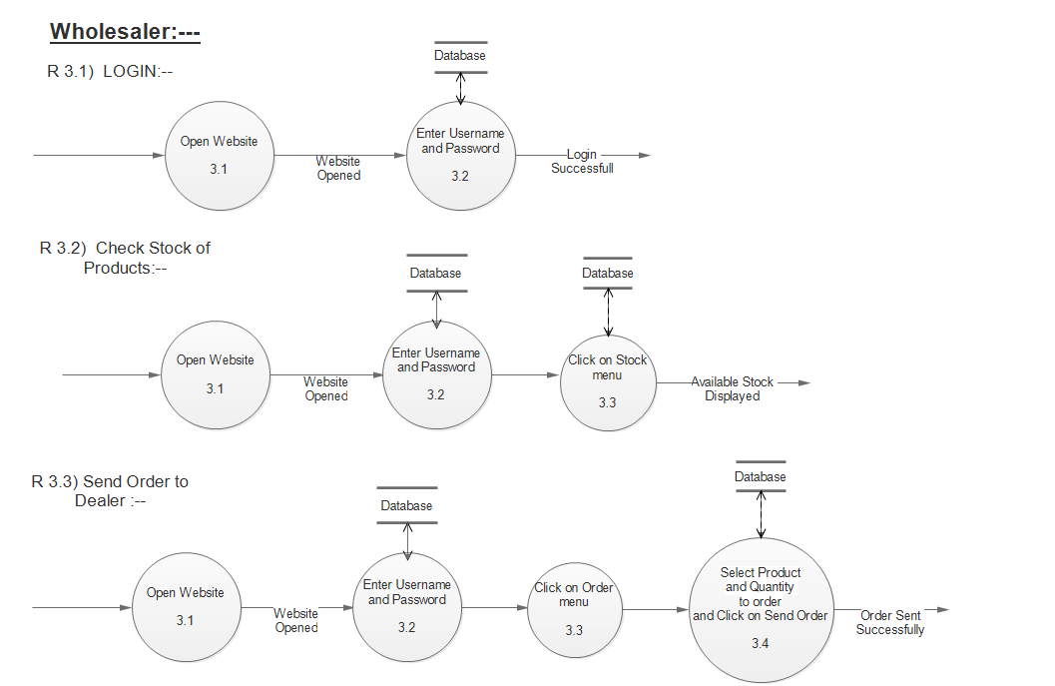
Level 1 DFD
Wholesaler:--

Slide 39
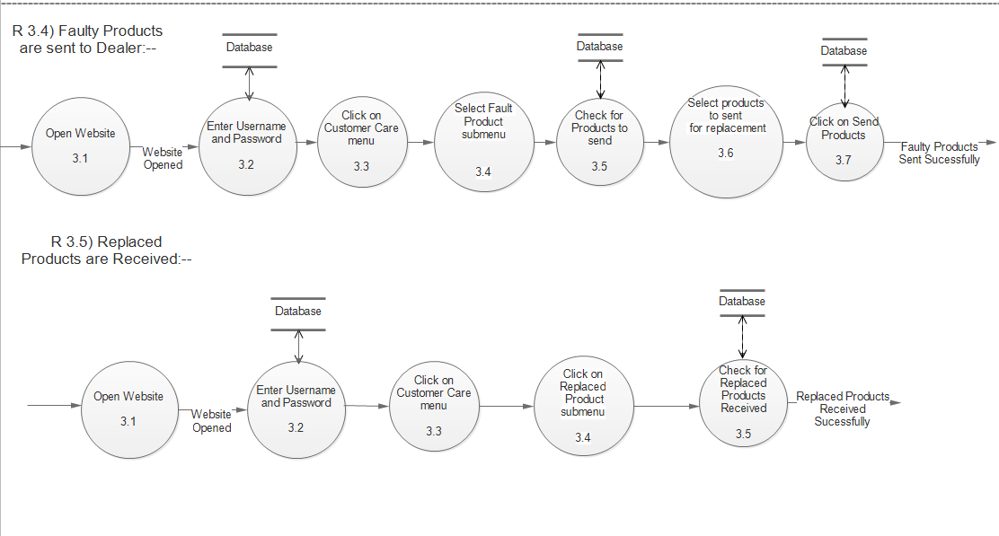
Level 1 DFD
Wholesaler:--

Slide 40
Data Dictionary
Area Master
SR no | Name | Data Type | Size | Constraint
1 | Area ID | Number | 5 | Primary Key
2 | Area Name | Varchar2 | 100 | Not Null
3 | Pin Code | Number | 6 | Unique Not Null
Users
SR no | Name | Data Type | Size | Constraints | Reference TO
1 | User ID | Number | 5 | Primary Key | -
2 | Name | Varchar2 | 50 | Not Null | -
3 | Email | Varchar2 | 50 | Not Null, Unique | -
4 | Password | Varchar2 | 10 | Not Null
5 | Area ID | Number | 5 | Not Null, Unique | Ref of Area Master
6 | Address | Varchar2 | 200 | Not Null | -
7 | Contact | Number | 10 | Not Null, Unique | -
8 | User type | Varchar2 | 7 | Not Null | Ref of User

Slide 41
Data Dictionary
Category
SR no | Name | Data Type | Size | Constraint
1 | category ID | Number | 5 | Primary Key
2 | Category Name | Varchar2 | 50 | Not Null
Product
SR no | Name | Data Type | Size | Constraint | Reference TO
1 | Product ID | Number | 5 | Primary Key | -
2 | Product Name | Varchar2 | 50 | Not Null | -
3 | Category ID | Number | 5 | Not Null | Ref of Category
4 | Product Price | Number | 5 | Not Null | -
5 | Description | Varchar2 | 100 | Not Null | -

Slide 42
Data Dictionary
Discount
SR no | Name | Data Type | Size | Constraint | Reference TO
1 | Discount ID | Number | 5 | Primary Key | -
2 | Product ID | Number | 5 | Not Null | Ref of Product
3 | Status | Varchar2 | 50 | Not Null | -
4 | Discount Percentage | Number | 3 | Not Null | -
Stocks
SR no | Name | Data Type | Size | Constraint | Reference TO
1 | Stock ID | Number | 5 | Primary Key | -
2 | Product ID | Number | 5 | Not Null | Ref of Product
3 | User ID | Number | 5 | Not Null | Ref of User
4 | Quantity | Number | 4 | Not Null | -
5 | Date | Date | - | Not Null | -

Slide 43
Data Dictionary
Order Master
SR no | Name | Data Type | Size | Constraint | Reference TO
1 | Order ID | Number | 5 | Primary Key | -
2 | Order Date | Date | - | Not Null | -
3 | Product ID | Number | 5 | Not Null, Unique | Ref of Product
4 | User ID | Number | 5 | Not Null, Unique | Ref of User
5 | Quantity | Number | 5 | Not Null | -
6 | Payment Status | Varchar2 | 50 | Not Null | -
7 | Cost | Number | 5 | Not Null | -
Outward
SR no | Name | Data Type | Size | Constraints | Reference TO
1 | Outward ID | Number | 5 | Primary Key | -
2 | Order ID | Number | 5 | Not Null, Unique | Ref of Order
3 | User ID | Number | 5 | Not Null, Unique | Ref of User
4 | Date | Date | - | Not Null | -
5 | Product ID | Number | 5 | Not Null, Unique | Ref of Product
6 | Quantity | Number | 5 | Not Null | -
7 | Remarks | Varchar2 | 100 | - | -

Slide 44
Data Dictionary
Returns
SR no | Name | Data Type | Size | Constraint | Reference TO
1 | Return ID | Number | 5 | Primary Key | -
2 | Return Date | Date | - | Not Null | -
3 | Product ID | Number | 5 | Not Null | Ref of Product
4 | Quantity | Number | 5 | Not Null | -
5 | User ID | Number | 5 | Not Null, Unique | Ref of User

Slide 45
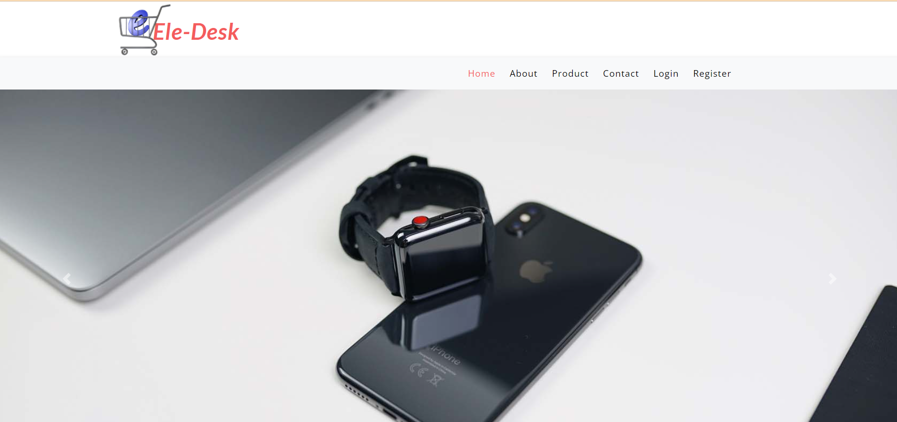
index.php

Slide 46
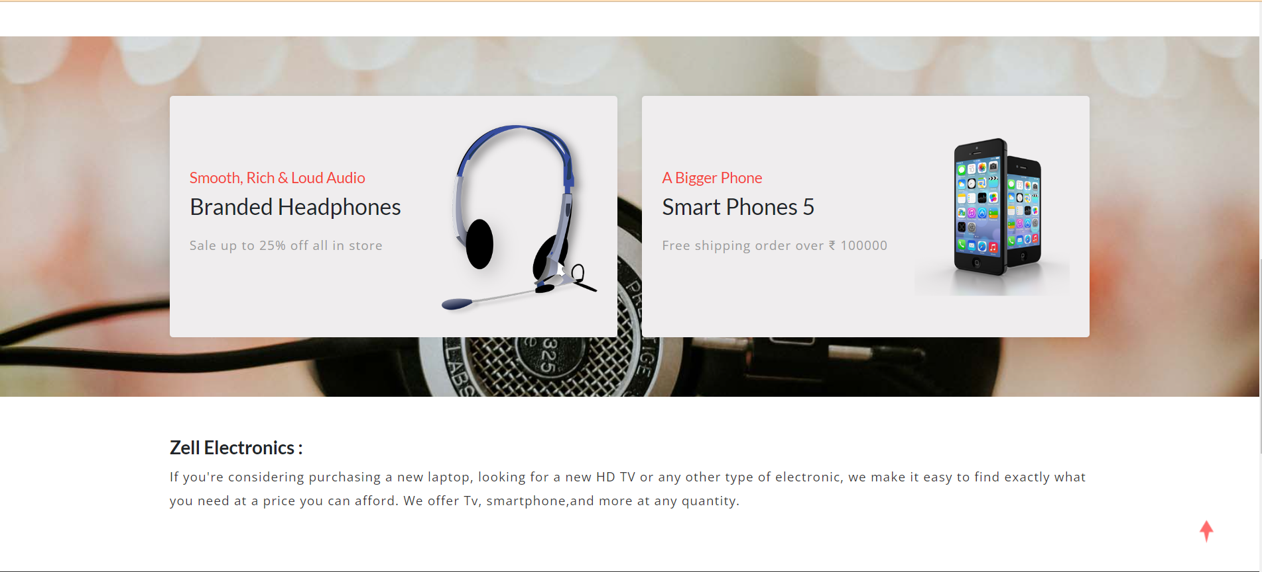
index.php

Slide 47
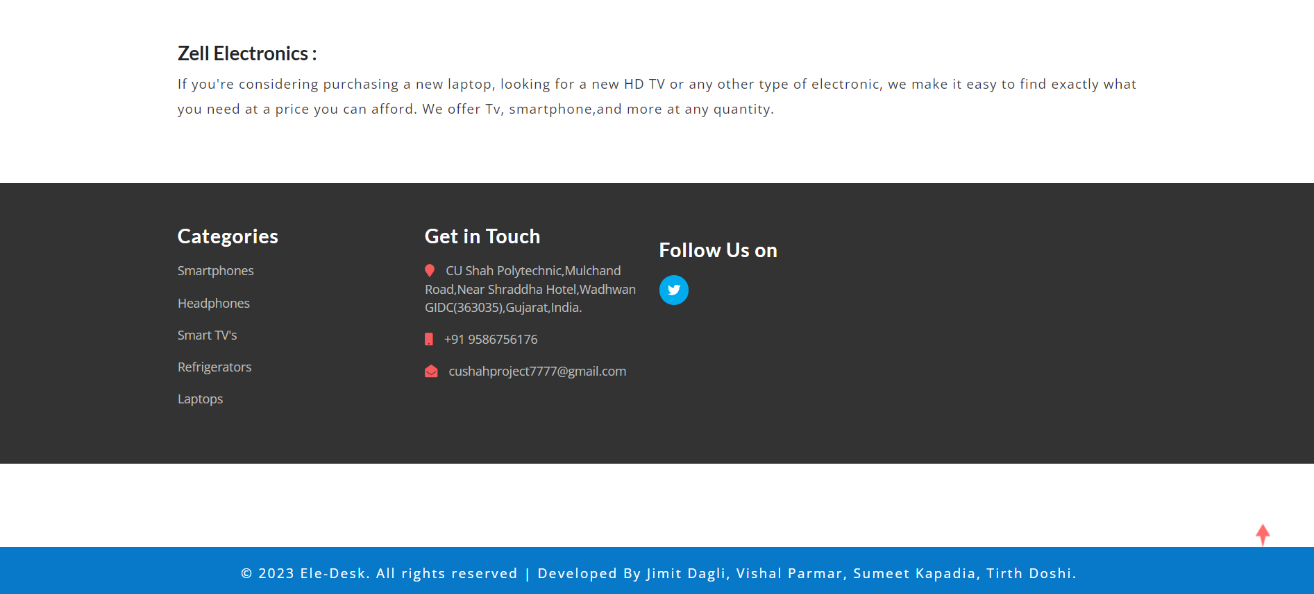
index.php

Slide 48
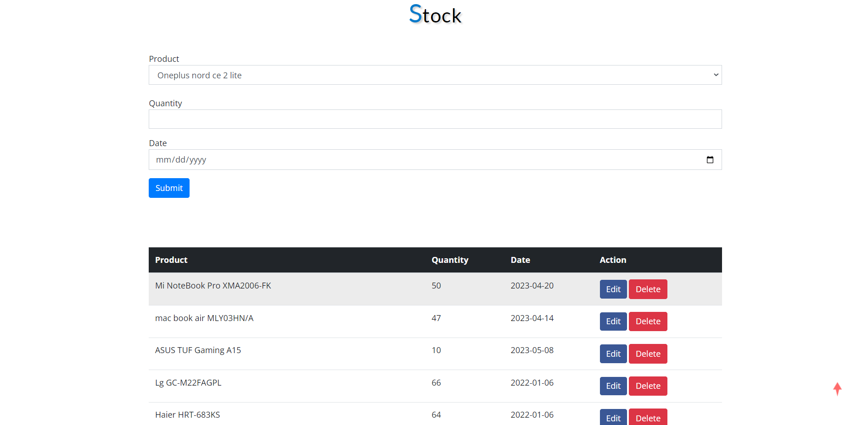
admin-stock.php

Slide 49
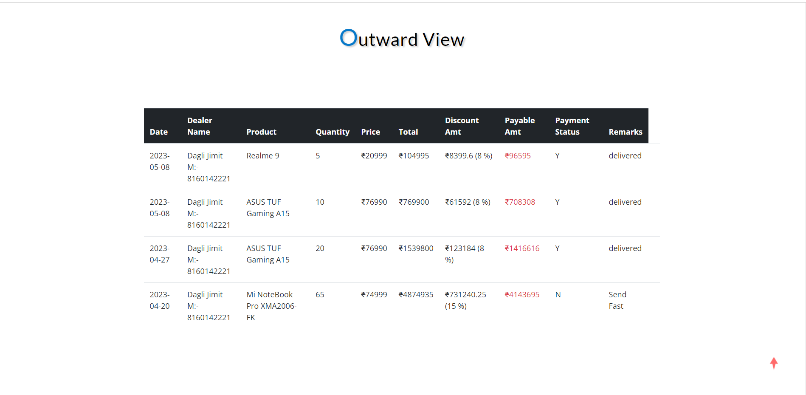
admin-outward-view.php

Slide 50
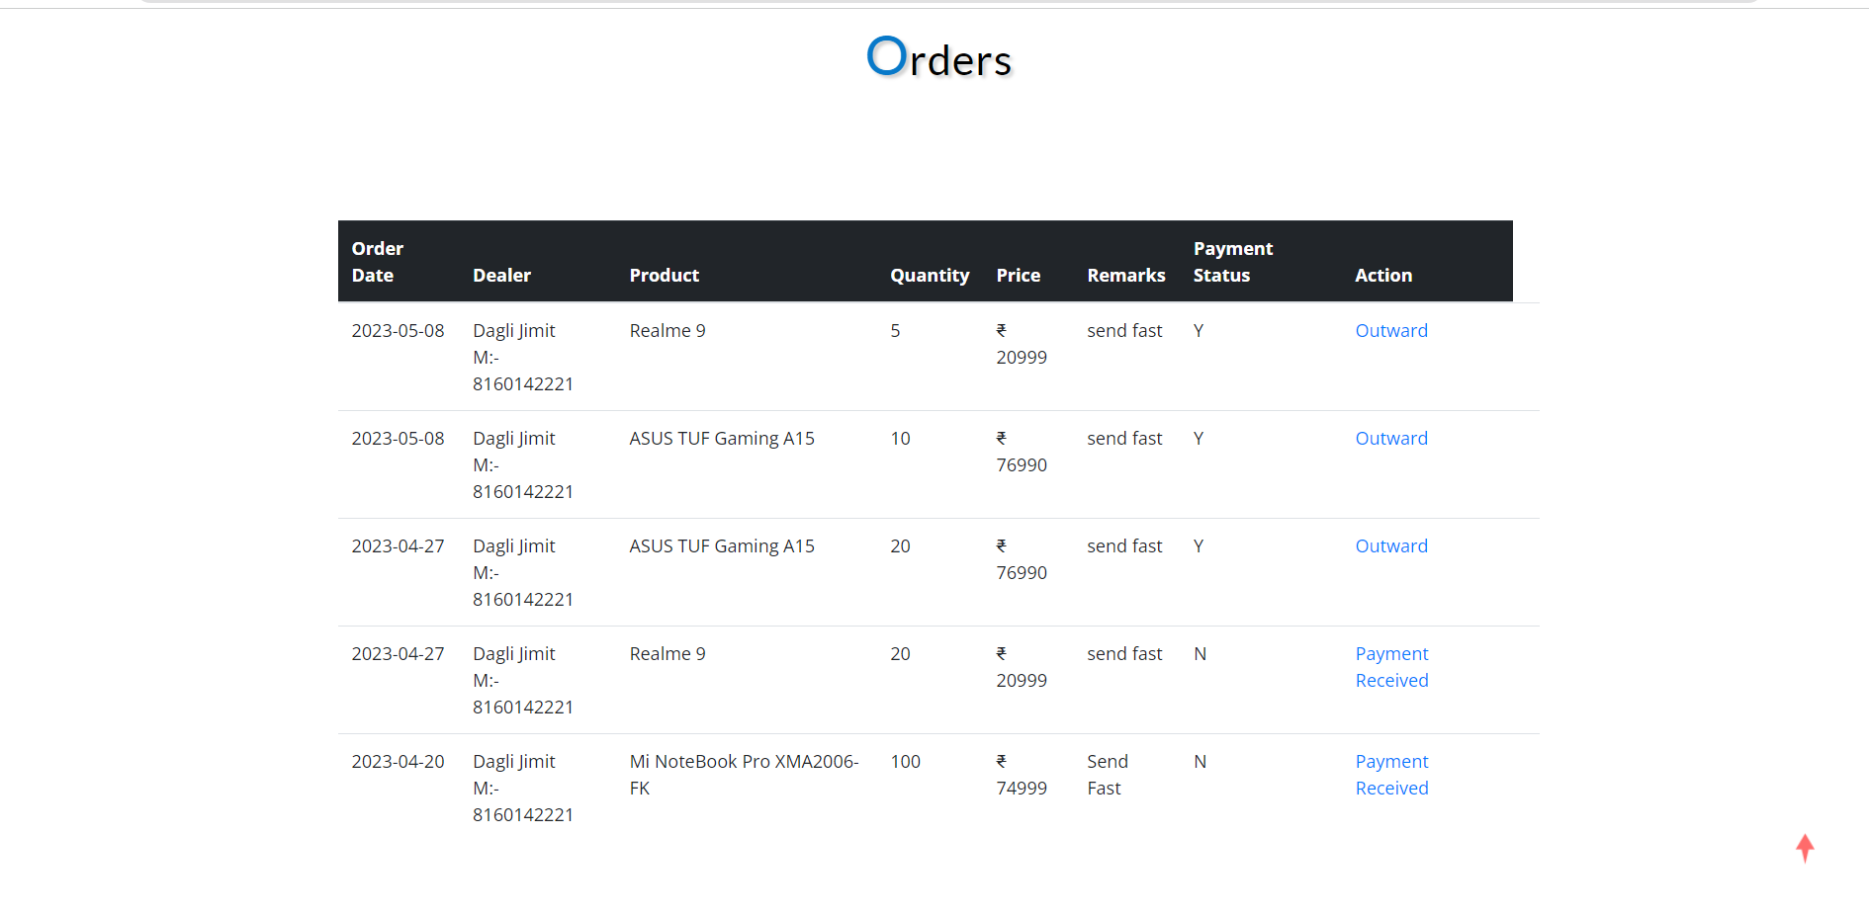
admin-order-view.php

Slide 51
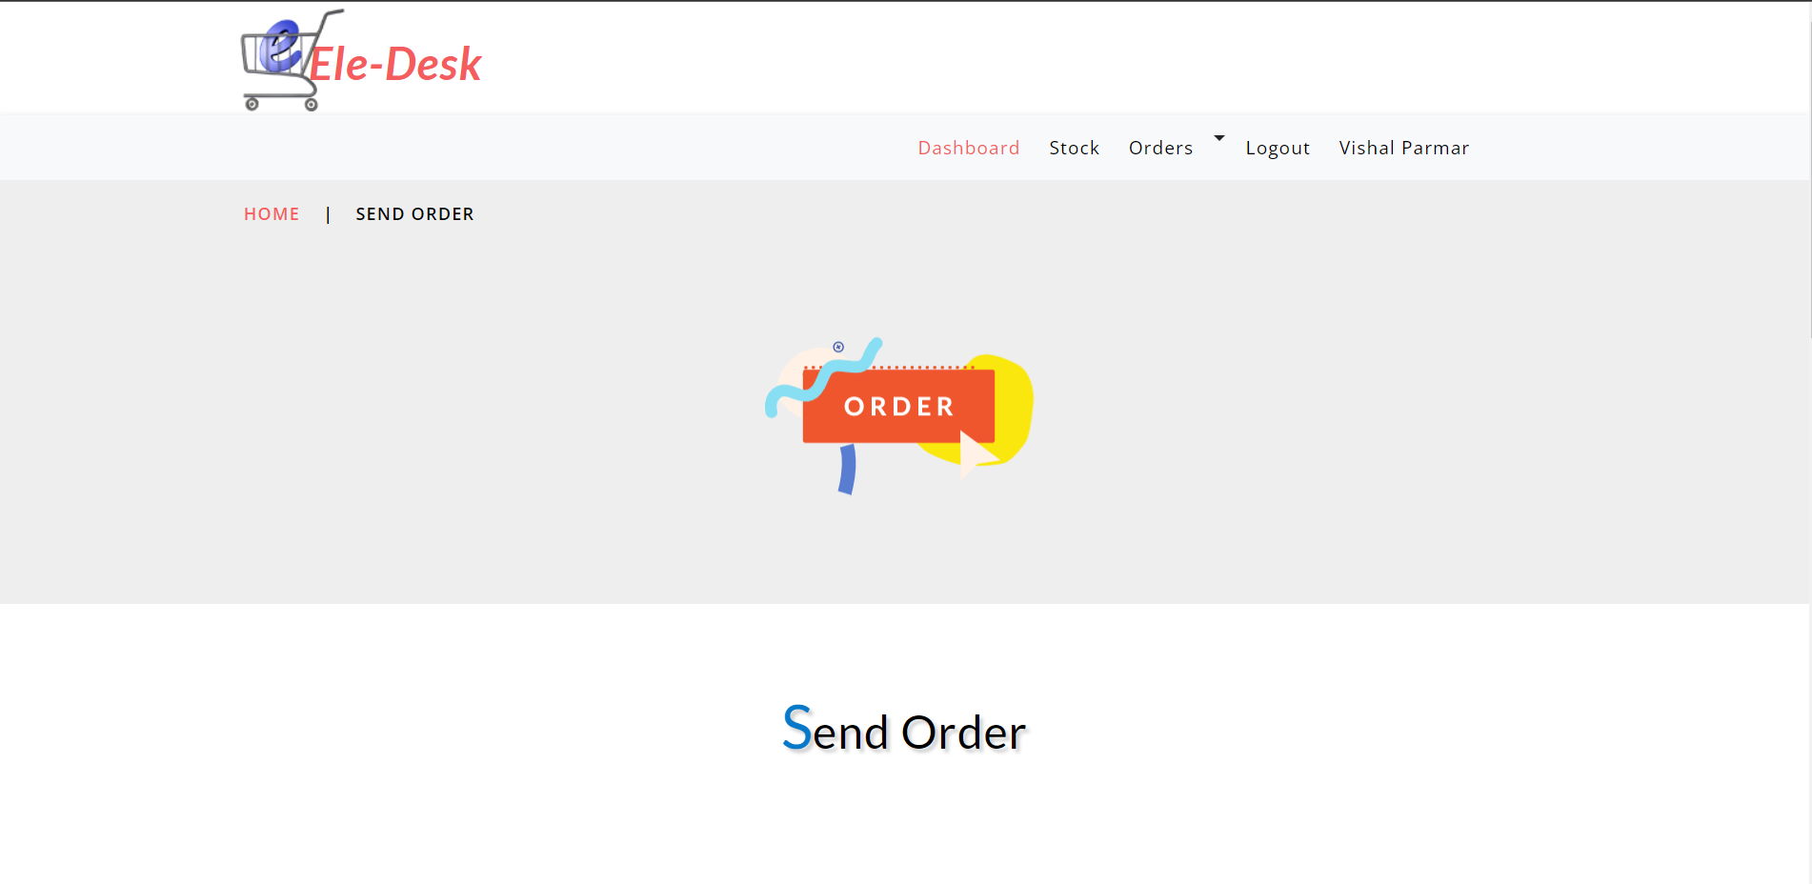
dealer-send-order.php

Slide 52
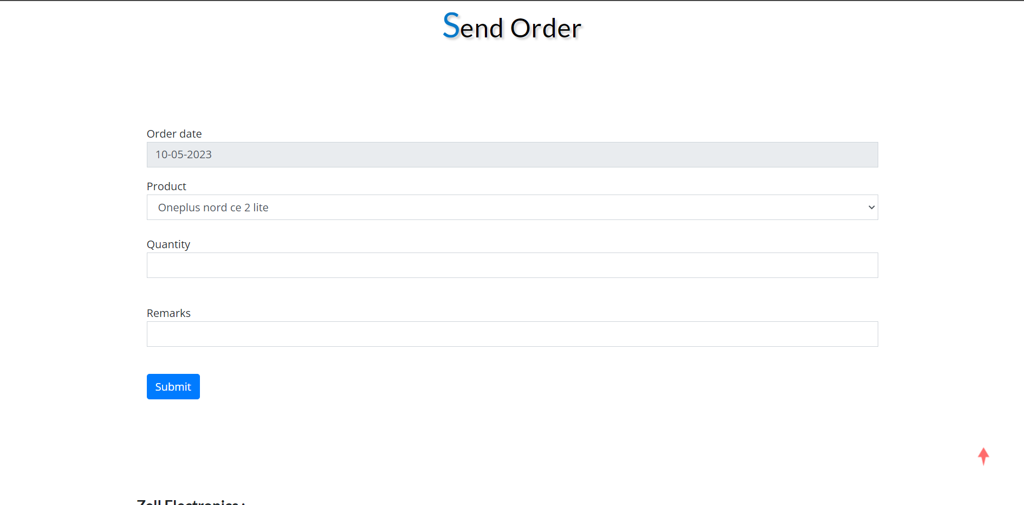
dealer-send-order.php

Slide 53
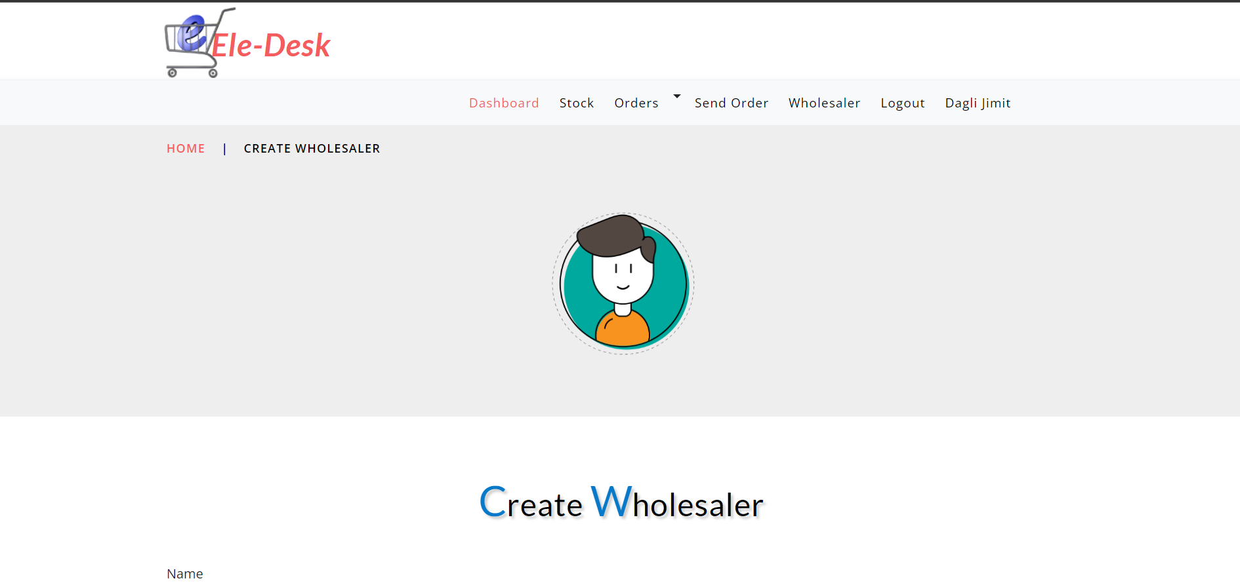
dealer-wholesaler.php

Slide 54
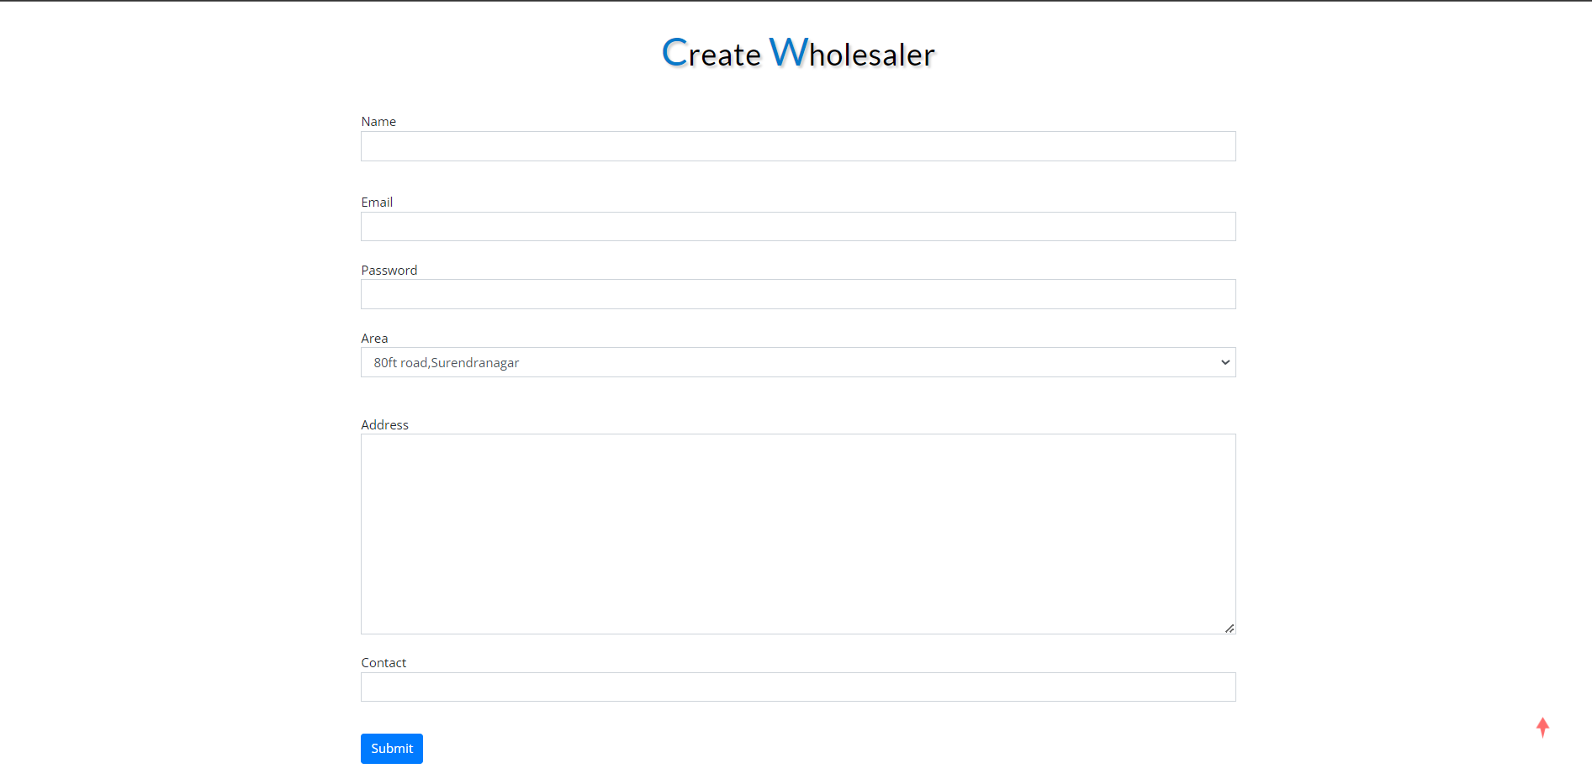
dealer-wholesaler.php

Slide 55
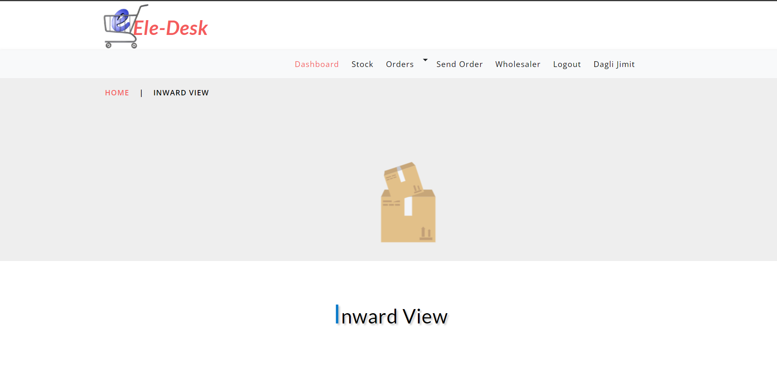
dealer-inward-view.php

Slide 56
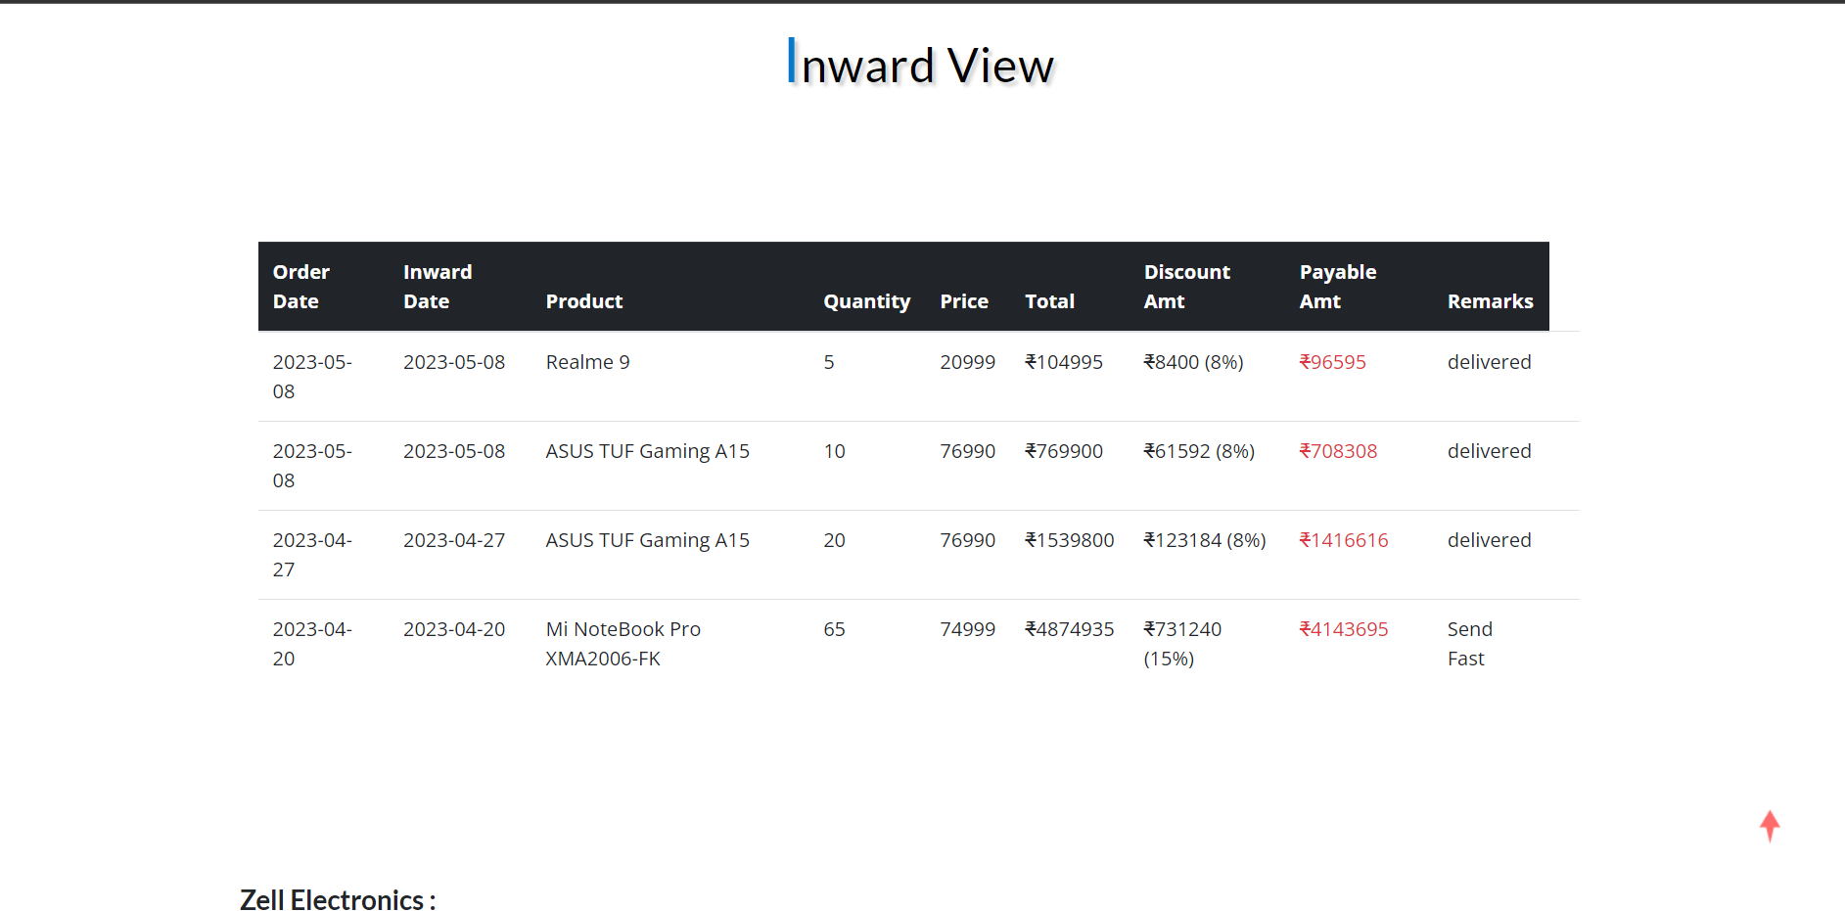
dealer-inward-view.php

Slide 57
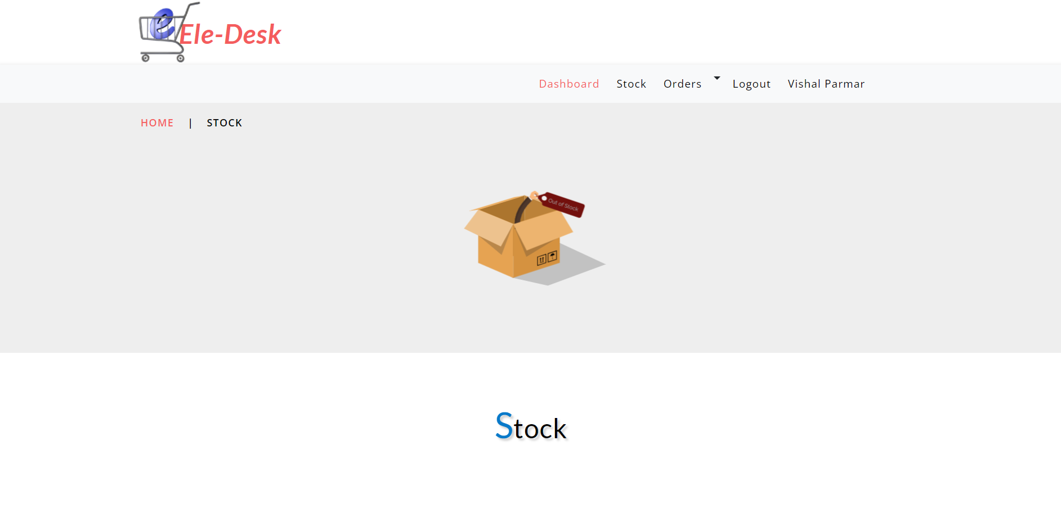
wholesaler-stock.php

Slide 58
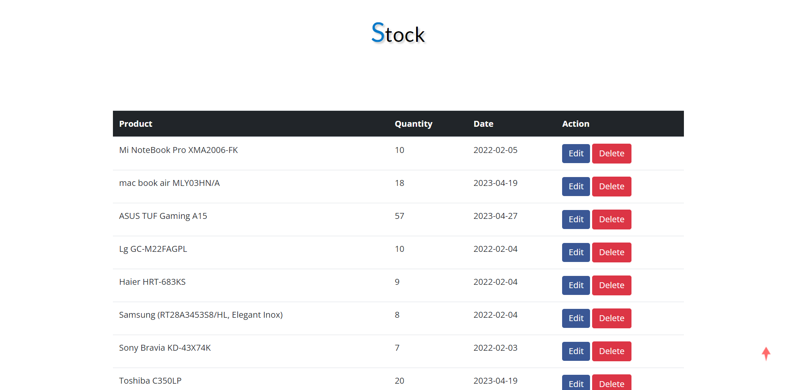
wholesaler-stock.php

Slide 59
wholesaler-send-order.php

Slide 60
wholesaler-send-order.php

Slide 61
6th Semester Plan:--
1 | GUI Design | 01-01-2023 | 31-01-2023 | 31
2 | Coding and Implementation | 01-02-2023 | 12-03-2023 | 40
3 | Deployment | 13-03-2023 | 01-04-2023 | 20
4 | Testing | 02-04-2023 | 16-04-2023 | 15
5 | Documentation | 17-04-2023 | 01-05-2023 | 15

Slide 62
THANK YOU

